Slide 1
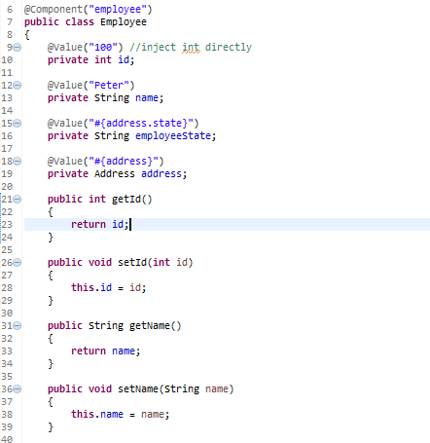
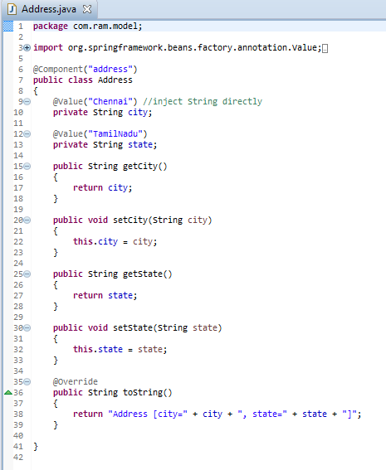
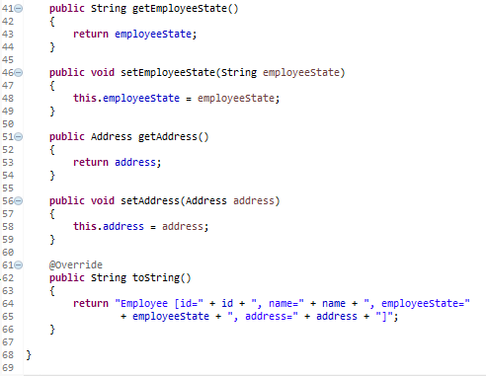
Spring Expression Language Dependency Injection using Annotation
#{address} – inject “addressBean” into “employeeBean” bean’s “address” property.
#{address.state} - inject “addressBean”‘s “state” property into “employeeBean” bean’s “employeeState” property.

Slide 2
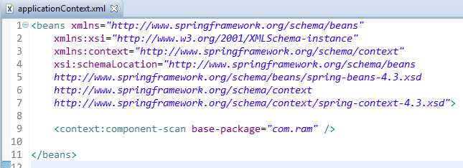
Spring Expression Language Dependency Injection using Annotation
Enable auto component scanning.

Slide 3
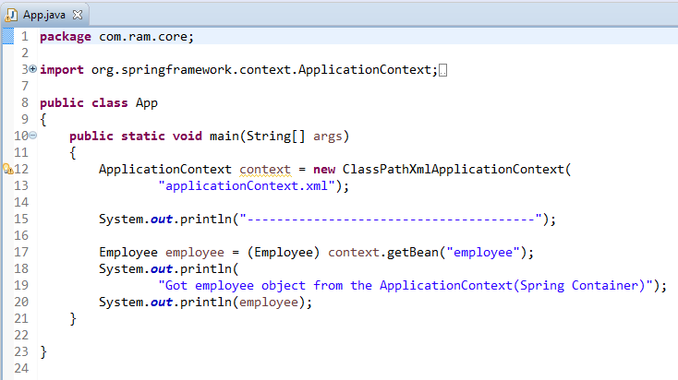
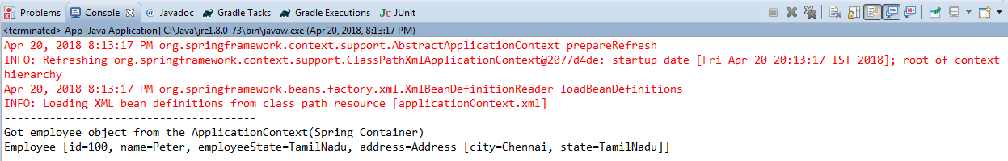
Spring Expression Language Dependency Injection using Annotation

